Slide 1
(Professional Practices in IT)
An Insight into Modern HR Practices
At Bloomrix
By:
Insha Javed (21K-3279)
Muhammad Tahir (21K-4503)
Sabika Shameel (21K-4606)

Slide 2


Introduction:
This presentation evaluates the HR practices of Bloomrix, a UK-based company, highlighting its recruitment, training, appraisals, and employee engagement policies.
About the Company:
Bloomix is a multinational company specializing in IT services and consulting. It is a medium-sized company that collaborates with over 250 small, medium, and large enterprises worldwide, driving digital transformation and enabling business growth.
Company website: http://www.bloomrix.com

Slide 3

MS. Ushna safdar (CHRMP)
About the Interviewee:
The interview was conducted with Ms. Ushna Safdar, the HR Manager at Bloomrix, who brings over four years of dedicated experience to her role. At Bloomrix, she combines strategic vision with critical thinking to create a dynamic and thriving workplace. Her MBA in HR Management from the University of Education further enhances her expertise in spearheading organizational change and fostering innovation.
Interviewee contact: hr@bloomrix.com

Slide 4
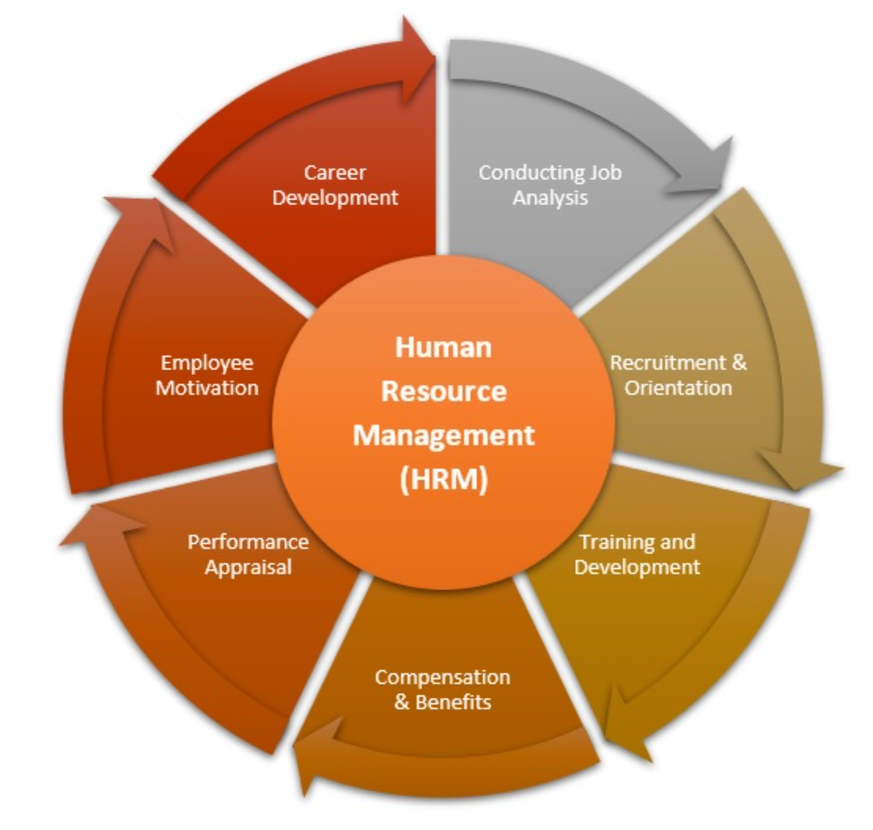
General HR Policies:
Protect the legal rights of employees and employers.
Ensure transparency through non-disclosure agreements and clearly defined contract clauses.
Outline job responsibilities, compensation, scope, position, and benefits.
Suggestions:
Update rules frequently to reflect changes in the law and get input from staff members regarding pay and benefits.

Slide 5
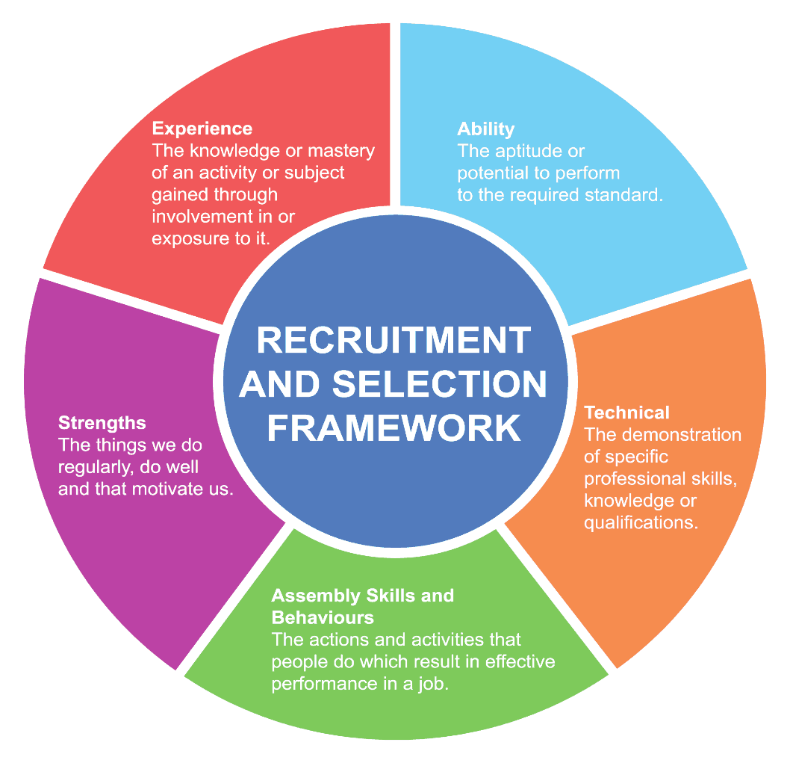
Recruitment and Selection
Assess team needs based on team lead requests.
Initial HR interview to evaluate qualifications.
Technical interview focusing on soft skills.
A final assessment will be done by a professional team before approval.
Suggestions:
To expedite the hiring process, use AI technologies and conduct organized interviews.

Slide 6

Staff Training and Development:
Collaborative effort between employees and management to identify Training Needs
Examples include introducing new technologies (e.g., Laravel) or employee requests for skill enhancement.
Training Programs:
Company-sponsored courses based on performance and job relevance.
Prioritize training for employees with roles closely aligned to organizational goals during tight budgets.
Suggestions: Provide opportunities for ongoing education and use performance measures to monitor the efficacy of training.

Slide 7
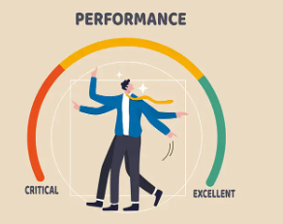
Appraisals and Performance
Regular reviews by the team lead.
Quarterly formal performance reviews to discuss achievements and areas of improvement.
Suggestions: After the appraisal, use 360-degree feedback and offer individualized development strategies.

Slide 8

Remuneration Policies
Salary determination by monitoring market trends, employee skills, experience, and industry benchmarks.
Incorporate feedback from CEOs and professional networks.
Align salary ranges with employee expectations, skill levels, and expertise, not just years of experience, to ensure pay satisfaction.
Suggestions: Introduce performance-based bonuses and conduct frequent market salary surveys.

Slide 9

Handling Dismissal and Redundancy
Termination Procedures:
Immediate termination for severe violations (e.g., harassment, data breaches) with no compensation.
For work-related performance issues, employees typically receive a notice period of 1-3 months.
Fairness is ensured by Hearing both sides of any dispute and cross-verify facts before making decisions.
Job Design and Employee Engagement
Suggestions: Put performance improvement strategies into action and provide outplacement services or severance packages.

Slide 10
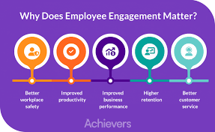
Employee Engagement:
Maintain morale through activities like birthday celebrations and regular tea/prayer breaks.
Use job rotation and enrichment strategies to align roles with employees' interests and skills.
Encourage role-switching and additional responsibilities after gaining sufficient experience.
Promotions typically come with salary increases to reward growth and performance.
Suggestions: Ask for input on job design on a regular basis, and use team-building exercises to promote a healthy work-life balance.

Slide 11

Discrimination and Workplace Diversity
Diversity and Inclusion:
Proactively prevent discrimination and promote gender diversity.
Address bias and involve HR as a moderator in conflict resolution.
Avoid discriminatory language in job postings; focus on skills and performance.
Accommodate employees with unique challenges (e.g., single parents) by offering flexible arrangements like remote work.
Suggestions: Extend hiring procedures to encompass a range of talent pools, guaranteeing equitable chances for applicants from all backgrounds.

Slide 12


